Slide 1
Computing for Sustainability
dr. Mansi Jhamb Associate Professor
USIC&T, GGSIPU

Slide 2
Sustainability….
age marked by increasingly urgent environmental challenges and by the critical importance of sustainable development.
timely initiative IN modern academic sphere, fostering a strong connection between
technology
research
policy making
successful practical implementation for a sustainable future.

Slide 3
Intelligent Computing for sustainability
applying intelligent computing techniques for sustainable development in
agriculture
digital healthcare
renewable energy
smart cities
autonomous systems.

Slide 4
highly relevant Areas for achieving sustainable development goals such as
zero hunger
good health and well-being
industry innovation and infrastructure.
bridges the gap between artificial intelligence and sustainable solutions with cutting-edge research and practical applications aimed at addressing environmental challenges.
how intelligent systems can drive transformation to meet global sustainability goals.
Through interdisciplinary approach, collaborations ARE ENCOURAGED across sectors to create sustainable solutions.

Slide 5
Why FPGA?
Versatile
Developers can test any number of variables after the board is built.
When changes are required, new configuration files are transferred onto the device that make new functionality available.
This flexibility allows OEMs to ship systems earlier in the design process. Developers design prototypes on FPGA to incrementally mature the design before finalizing it at tape-out.
FPGAs are often used in commercial applications where there’s a need for parallel computing and the requirements are dynamic, such as for telecoms and avionics [2].

Slide 6
FPGAs ……. the best solution
Low Price
Hardware prototyping, to verify digital hardware designs without the cost of ASIC
Hardware acceleration, to speed designs.
Space avionics, where radiation hardened FPGAs in satellites can receive new configuration files to execute upgrades, install new features, or fix bugs without physical access.
Neural networks, where the design topology better fits an FPGA and can accelerate matrix multiplication[2]

Slide 7
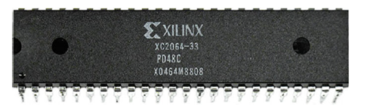
FPGA Hardware Evolution
Xilinx corporation (acquired by AMD in 2022) invented the first commercial FPGA– XC2064 in 1985. The device contains 64 programmable logic units consisting of two 3-input look-up tables (LUTs) and an flip-flop (FF), enabling true “field” programmability for the first time. IEEE listed Xilinx XC2064 as one of the “25 microchips that shook the world” in 2009 and inducted it into the “chip hall of fame” in 2017 [3].
Fig 1: World’s first fpga—xilinx XC2064

Slide 8
FPGA structure [4]
Basic components:
programmable logic element ( expresses a logic function)
programmable i/o element ( provides an external interface)
programmable interconnect element (connects different parts)
there are also digital signal processing (dsp) units and embedded memory to increase the calculation ability, and phase-locked loop or delay-locked loop to provide a clock network.
by downloading the design data to these elements, FPGA can implement the desired digital circuit

Slide 9
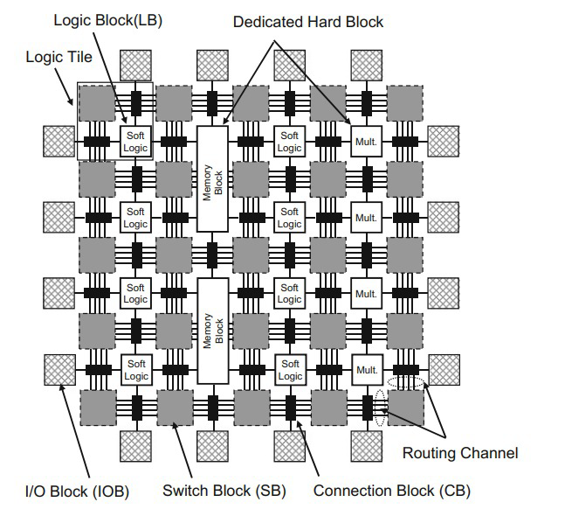
An island-style FPGA has logic elements (logic block), i/o elements placed on the periphery (i/o block), routing elements (switch block, connection block and routing channel), embedded memory, and multiplier blocks. A set of neighboring logic blocks, a connection block, a switch block is called a logic tile, arranged in a two-dimensional array. the logic block and multiplier block are used as hardware resources to realize logic functions, while the memory block provides storage. multiplier & memory blocks, dedicated for specific usages, are called “hard logic” functions implemented with logic blocks are called “soft logic” logic blocks are named differently among fpga vendors such as configurable logic block (CLB) in Xilinx FPGA and logic array block (LAB) in Altera
Island Style FPGA

Slide 10
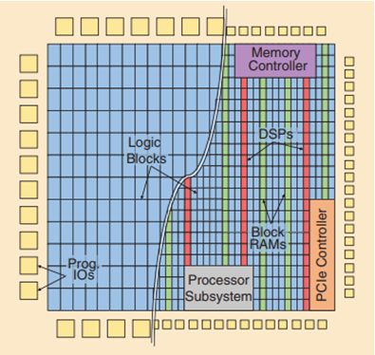
progression
FPGAs evolved from simple arrays of programmable logic and IO blocks to complex heterogeneous multi-die systems with embedded block rams, digital signal processing (DSP) blocks, processor subsystems, diverse high-performance external interfaces, system-level interconnect, and more[5].
Fig 2: Early FPGA Architecture vs modern heterogenous FPGA Architecture[2].

Slide 11
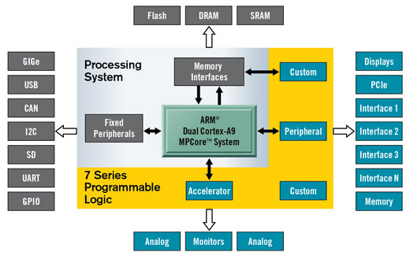
Xilinx Zynq-7000 AP SoC [6]

Slide 12
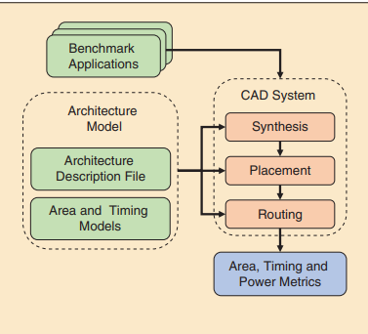

Slide 13

Cryptography
Cryptography, or cryptology : the study of securing communication in the existence of third parties.
protect the transaction of data from others.
constructs algorithms and protocols to protect sensitive data from adversaries.
FPGAs offer several advantages over traditional software implementations
faster processing speeds
lower power consumption
These benefits make FPGAs an attractive choice for applications that need fast encryption and decryption.

Slide 14
References
Innovative And Intelligent Computing For Global Sustainability Publisher: Springer Cham https://doi.org/10.1007/978-3-031-97385-7
‌
‌
‌
‌
‌
‌

